Slide 1
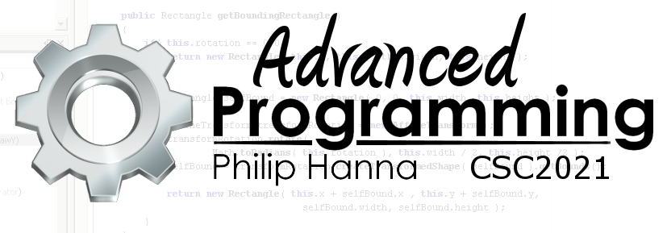
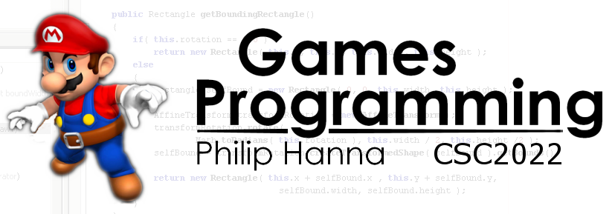
The Compilation Process
How code gets to be compiled
Part 2 – The stages of compilation

Slide 2

The
Compilation Process

Slide 3

This section explores how C++ source code gets compiled into machine code.
By understanding this process, and in particular, how the compiler tries to optimise your code will help you write code that helps the compiler help you!
Notes:
More information on how your C++ source code gets compiled into machine code now follows. Understanding this process, and in particular, how the compiler tries to optimise your code will help you write code that helps the compiler help you!

Slide 4
Lexical Analysis (Scanner)
Intermediate Code Generation
Optimisation (pre-native)
Syntax Analysis (Parser)
Native Code Generation
Optimisation (post-native)
Phases
Compilation tends to sub-divided into a number of interlinked phases:
Lexical analysis
Syntax analysis
Intermediate code generation
Native code generation
Code optimization
Notes:
Compilation phases:
Compilation tends to broken up into a number of phases:
Lexical analysis
Syntax analysis
Intermediate code generation
Native code generation
Code optimization

Slide 5
Lexical Analysis (Scanner)
Intermediate Code Generation
Optimisation (pre-native)
Syntax Analysis (Parser)
Native Code Generation
Optimisation (post-native)
Phases
Typically the parser (syntax analysis) drives the process and calls the scanner (lexical analysis) to extract some input to be parsed before then sending this to the intermediate code generator.
Once the code generators have emitted and optimized some native code, the parser then repeats the process for the next chunk of source input.
Notes:
The phases tend to execute in parallel with one another.
Typically the parser (the syntax analysis phase) drives the process and calls the scanner (lexical analysis phase) to extract some input to be parsed before then sending this to the intermediate code generator which. Once the code generators have emitted and optimized some native code, the parse then repeats the process for the next chunk of source input.

Slide 6

Lexical analysis
The scanner breaks up the source code into lexical tokens (lexemes) (e.g. keywords, arguments, etc.)
A token data package is created for each lexeme, e.g. the token for the character string “675” would identify this as a literal constant of type integer with an numerical attribute value of 675.
By pre-processing the source file into a sequence of tokens the efficiency of the parser is notably increased (it need only process numerical tokens and not perform expensive string parsing).
Notes:
The scanner is responsible for breaking up the source code into lexical tokens (lexemes) such as reserved keywords, operators, arguments, etc.
For each lexeme a data package known as a token is created to be passed to the parser. e.g. the token for the character string “675” would identify this as a literal constant of type integer with an numerical attribute value of 675.
The string-based parsing of the source file is a relatively time-confusing operation. By preprocessing the source file into a sequence of tokens the efficiency of the parser is massively increased as it need only process numerical tokens and not strings.

Slide 7
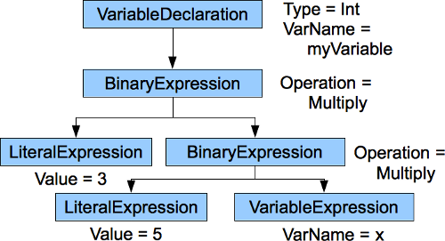
Syntax analysis (parsing)
The parser checks if the source code is syntactically correct. It also reorganises the source tokens into a more complex data structure that better captures the semantics of the program (often called an abstract syntax tree or AST).
By reorganising the source, the code generation and optimization phases are more easily able to reference different parts of the program and parse the program structure.
Notes:
The parser checks if the source code is syntactically correct (compilation errors are typically reported by the parser).
The parser is also responsible for reorganising the source tokens into a more complex data structure that represents the meaning or semantics of the program (often called an abstract syntax tree or AST).
By reorganising the source into a tree based structure it becomes possible for the code generation and optimization phases to more easily reference different parts of the program and parse the program structure.

Slide 8

Code Generation
The intermediate code generation phase translates the AST representation into a quasi-machine code form.
By doing so, it becomes possible to easily support code generation for several different CPUs (cross compilers) as all CPU-independent activities can be located within this stage.
For the same reason, the optimisation phase is often broken into two stages: a CPU-independent component and a CPU-dependent component.
Notes:
The parser checks if the source code is syntactically correct (compilation errors are typically reported by the parser).
The parser is also responsible for reorganising the source tokens into a more complex data structure that represents the meaning or semantics of the program (often called an abstract syntax tree or AST).
By reorganising the source into a tree based structure it becomes possible for the code generation and optimization phases to more easily reference different parts of the program and parse the program structure.

Slide 9
1 | void foo (int i)
2 | {
3 | a[0] = i+0;
4 | a[1] = i*0;
5 | a[2] = i-i;
6 | a[3] = 1+i+1;
7 | }
1 | void foo (int i)
2 | {
3 | a[0] = i;
4 | a[1] = 0;
5 | a[2] = 0;
6 | a[3] = 2+i;
7 | }
Code Optimisation
The optimisation phase translates the intermediate code into a more efficient form. Mostly this involves removing extraneous entries from the AST.
Compiler optimisation is next explored in a bit more depth.
1 | void foo()
2 | {
3 | int i;
4 | i = 1;
5 | global = 1;
6 | global = 2;
7 | return;
8 | global = 3;
9 | }
1 | void foo()
2 | {
3 | global = 2;
4 | return;
5 | }
Notes:
The optimisation phase translates the intermediate code into a more efficient form. Mostly this involves removing extraneous entries from the AST.

Slide 10

Linkers

Slide 11
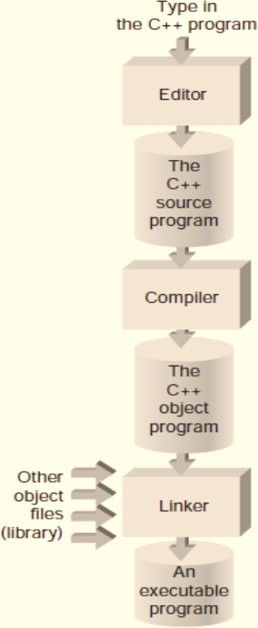
Compilers translate the source language into object code that contains machine instructions and binary runtime data along with meta-information that allows a linker/loader program to combine various object modules to produce a complete executable.
This permits separate libraries, etc. to be linked together with the source.
Notes:
Compilers translate the source language into object code that contains machine instructions and binary runtime data along with meta-information that allows a linker/loader program to combine various object modules to produce a complete executable. This permits separate libraries, etc. to be linked together with the source.

Slide 12

Most compilers emit code using one or more standardised object file formats (which permit linkers to share object file utilities such as dump tools, disassemblers, etc).
Examples of common object module formats include: OMF (Object Module Format), COFF (Common Object File Format), PE/COFF (Microsoft’s variant on COFF), and ELF (Executable and Linkable Format).
Notes:
Most compilers emit code using one or more standardised object file formats (which permits linkers to share object file utilities such as dump utilities, disassemblers, etc).
Examples of common object module formats include: OMF (Object Module Format), COFF (Common Object File Format), PE/COFF (Microsoft’s variant on COFF), and ELF (Executable and Linkable Format).

Slide 13

Aside: Different Compilers

Slide 14

Numerous C++ compilers are available (MS Visual C++ is likely the most popular).
Most modern compilers are packaged within a wider IDE that assists the programmer through project tools and management.
Projects can include OS specific windows-based applications, DLLs, character-mod executable, static library, console application, etc. 64-bit or 32-bit variants may be offered.
Notes:
Numerous C++ compilers are available (MS Visual C++ is likely the most popular). Most modern compilers are packaged within a wider IDE that assists the programmer through project tools and management.
Projects can include OS specific windows-based applications, DLLs, character-mod executable, static library, console application, etc. 64-bit or 32-bit variants may be offered.

Slide 15
Most IDEs offer a common set of build options, including:
In Debug mode the compiler adds extra code that increases the program size, slows program execution, but enables debugging features. This overhead is removed in Release mode.
Compile
Build or Make
Build All
Run or Execute
Debug
Compile the code in the file that is currently open.
Compile the code for all modified source code files in the project.
Compile all the source code files from scratch.
Commence execution.
Run the program but with debugger support enabled.
Notes:
Most IDEs offer a common set of build options, including:
Compile: Compile the code in the file that is currently open.
Build or Make: Compile the code for all the source code files in the project (or for those which have been modified since the last build).
Build All: Compile all the source code files from scratch.
Run or Execute: Commence execution.
Debug: Run the program but with debugger support enabled.
In Debug mode the compiler adds extra code that increases the program size, slows program execution, but enables detailed debugging features. This overhead is removed in Release mode.

Slide 16

Key takeaways:
A good compiler will work hard to help you write efficient programs (when you tell it to do so).

